Slide 1

KNOW
YOUR CITY.
A living map that says what is happening, and how sure it is.
People · Places · Possibilities
Notes:
Open on the live map. The deck follows the product: what it does today, on real data, and how sure it is.

Slide 2
Maps show you where. They do not tell you what is going on.
1
2
3
Why is this road jammed?
Which way home is calmer?
What happens in an hour?
A red line says slow. It does not say why, or whether this is normal for 6 pm on a Tuesday.
Apps pick the fastest route, not the one with fewer problems on it.
A map is a photo of now. Cities keep moving.
Notes:
Three everyday questions no map answers today.

Slide 3
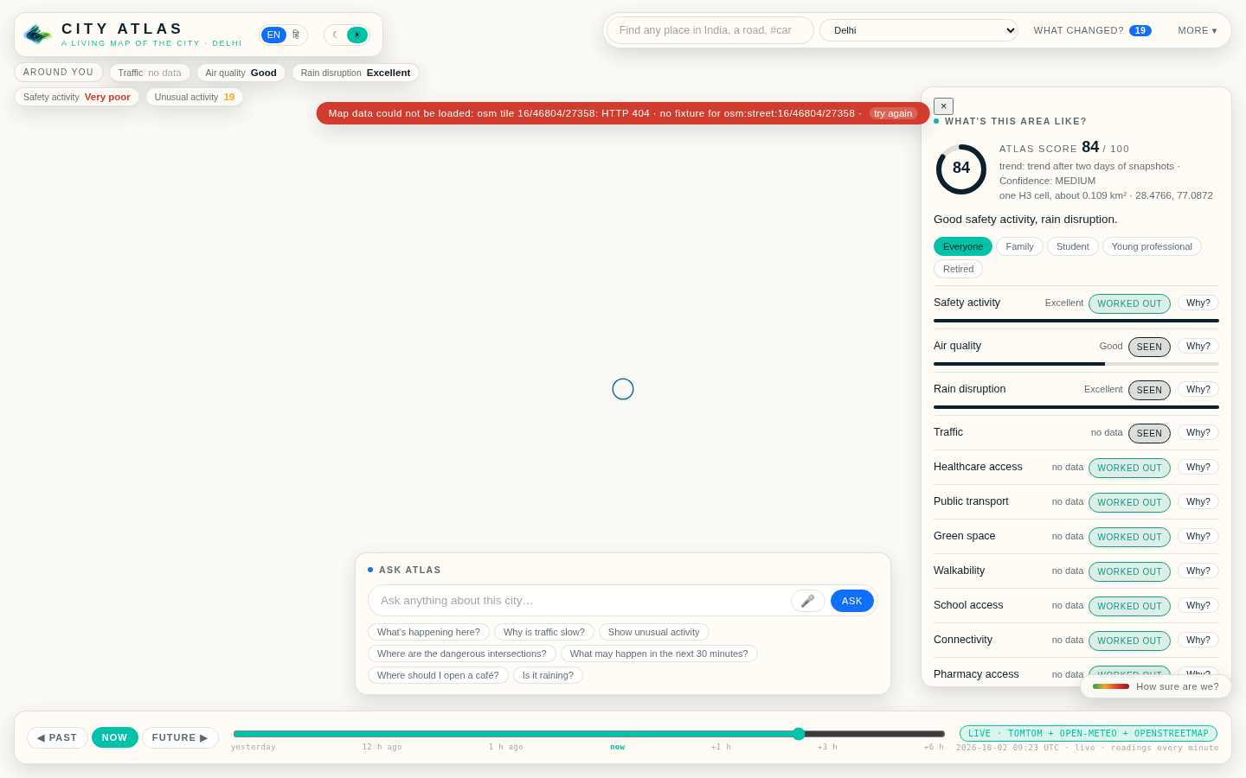
City Atlas turns the map into a living city you can question.
Real streets, buildings and green for all of India, streaming in as you move.
Live traffic in the colours everyone already knows, with cars that move at the measured speed.
Incidents, air, rain and the city’s own memory of what is usual at this hour.
Ask Atlas in English or Hindi. Every answer lists the facts it came from.
Notes:
Screenshot: the live map after searching for a place across India.

Slide 4
It always tells you how sure it is.
SEEN
Came from a real source: a map, a feed, a camera.
Solid ink.
WORKED OUT
Calculated from what was seen, like “this road is at 30% of its usual speed”.
Soft colour.
PREDICTED
What may come, from what the memory has seen before. Always carries a confidence.
Dashed ghost lines.
NO DATA
Where a reading is missing it says so. Nothing is ever made up.
Left blank.
Notes:
The evidence classes carried by every card, bubble and answer.

Slide 5
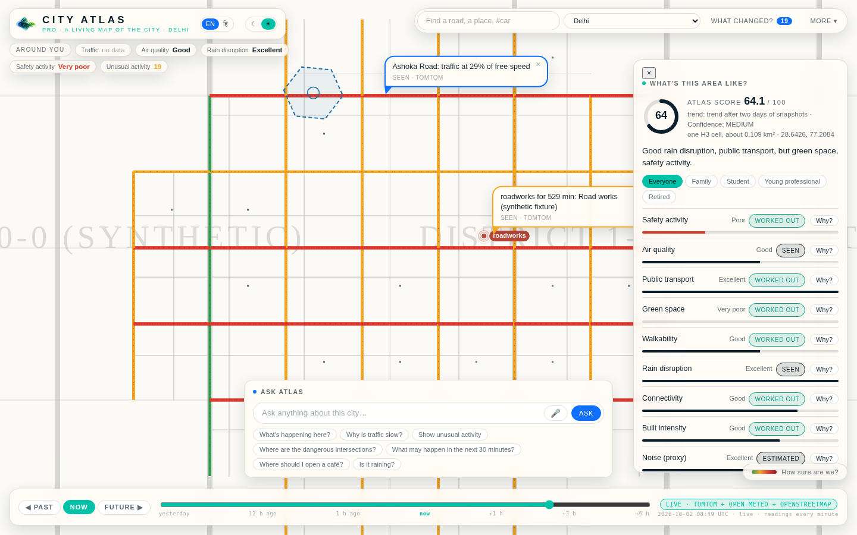
Click anywhere. Every place gets a score, and every score answers “why?”
One hexagon of the city, about 0.1 km²: traffic against its usual, incidents, air, rain, green space, healthcare, schools, transport, walkability, connectivity.
WHY opens the evidence: the lines it was worked out from, its class, a confidence, the source, time and resolution.
The same facts re-weighted for a family, a student, a young professional or a retiree.
Flood and population stay “no data” until their adapters exist.
Notes:
Screenshot: the place intelligence card with a site-finder outline on the map.

Slide 6
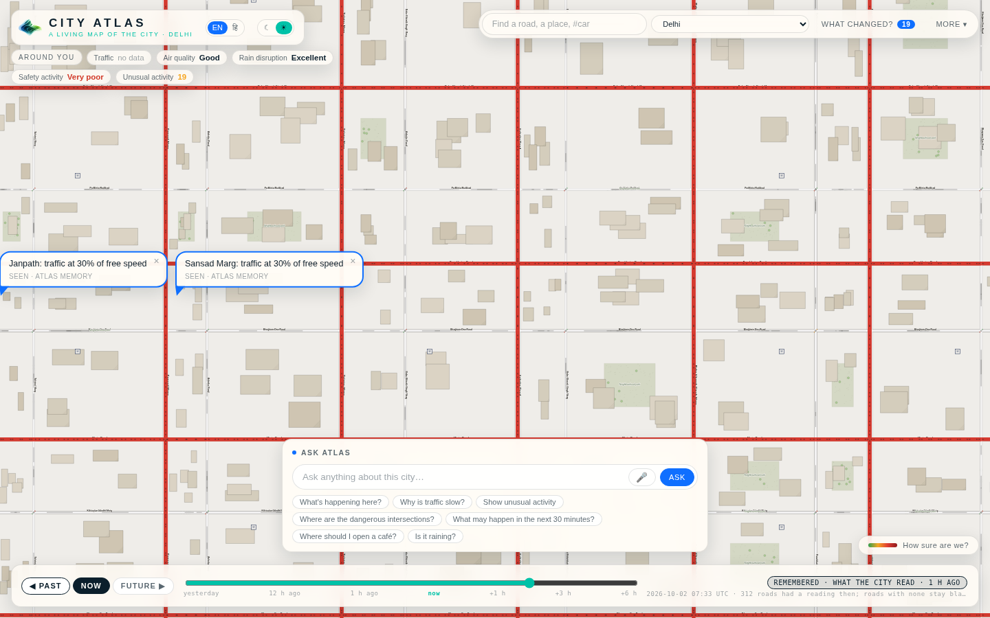
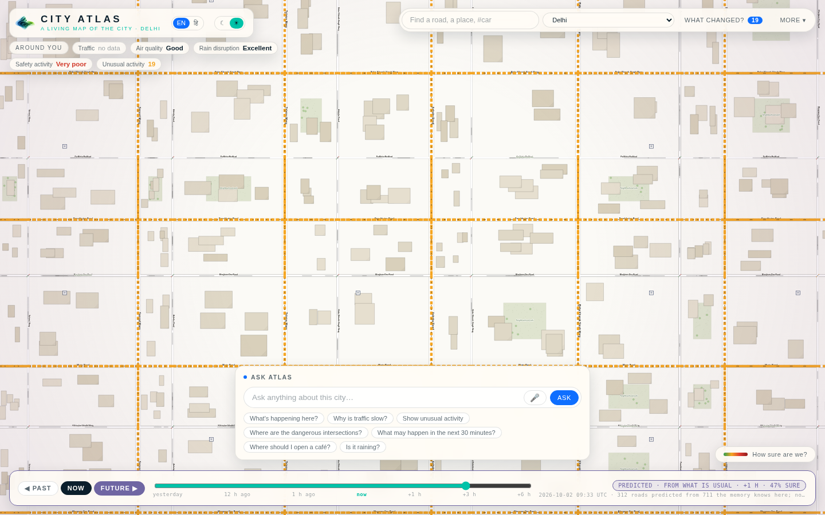
Past. Now. Future. Time is part of every place.
REMEMBERED
What the city actually read at that minute. Nothing interpolated; roads without a reading stay blank.
PREDICTED
What each road usually reads at that hour, with today’s unusual traffic fading out, dashed, with a confidence.
Notes:
The time bar: three buttons and a slider from yesterday to six hours ahead.

Slide 7
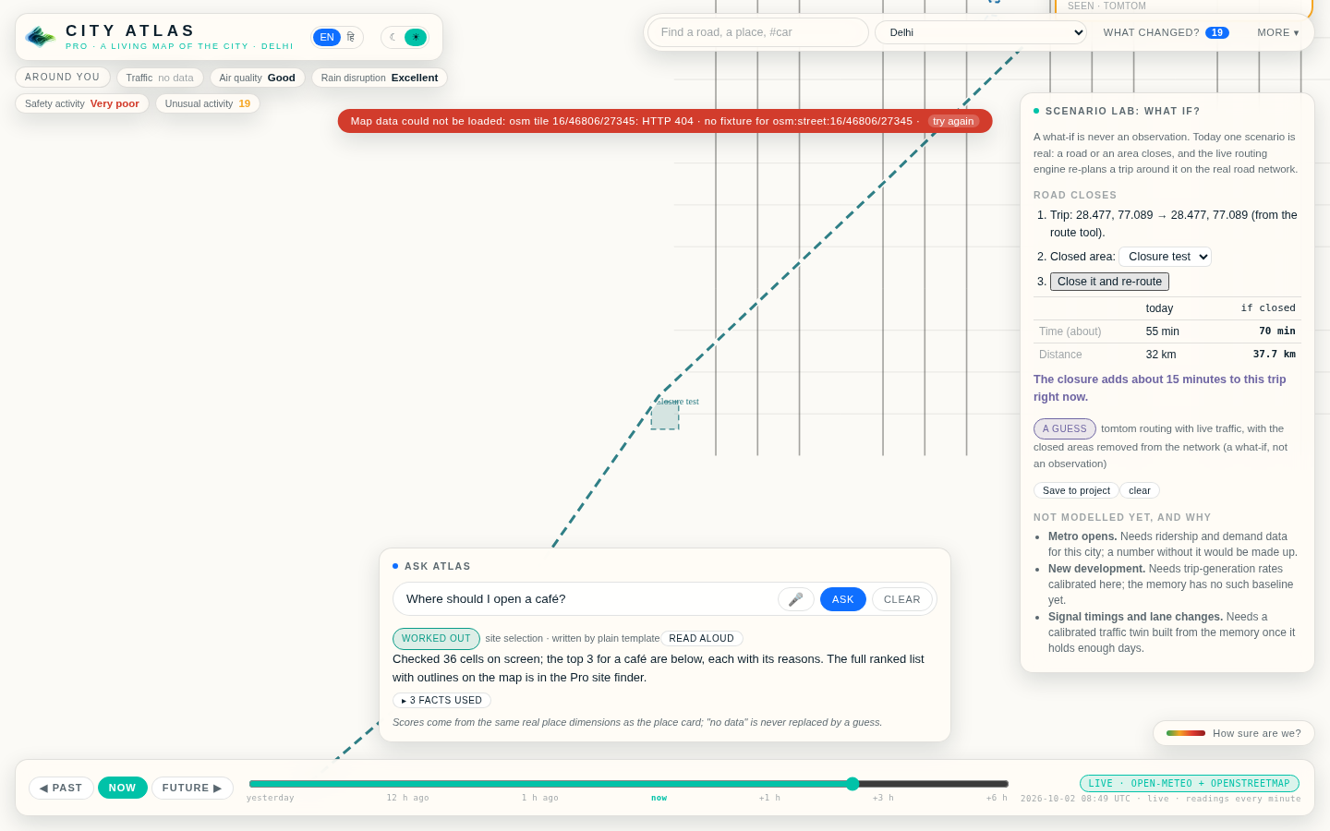
Ask the city. Get evidence, not guesses.
“Why is traffic slow?” “Show unusual activity.” “Where should I open a café?”
A question chooses the tools behind the answer: the place state, the memory, the change ranking, the router, the site finder.
The writer phrases facts; it never adds one. It says when a line is a guess.
What changed? ranks the meaningful changes since yesterday for the view on screen, each with its source.
Notes:
Screenshot: Ask Atlas answering a site question while the Scenario Lab is open.

Slide 8
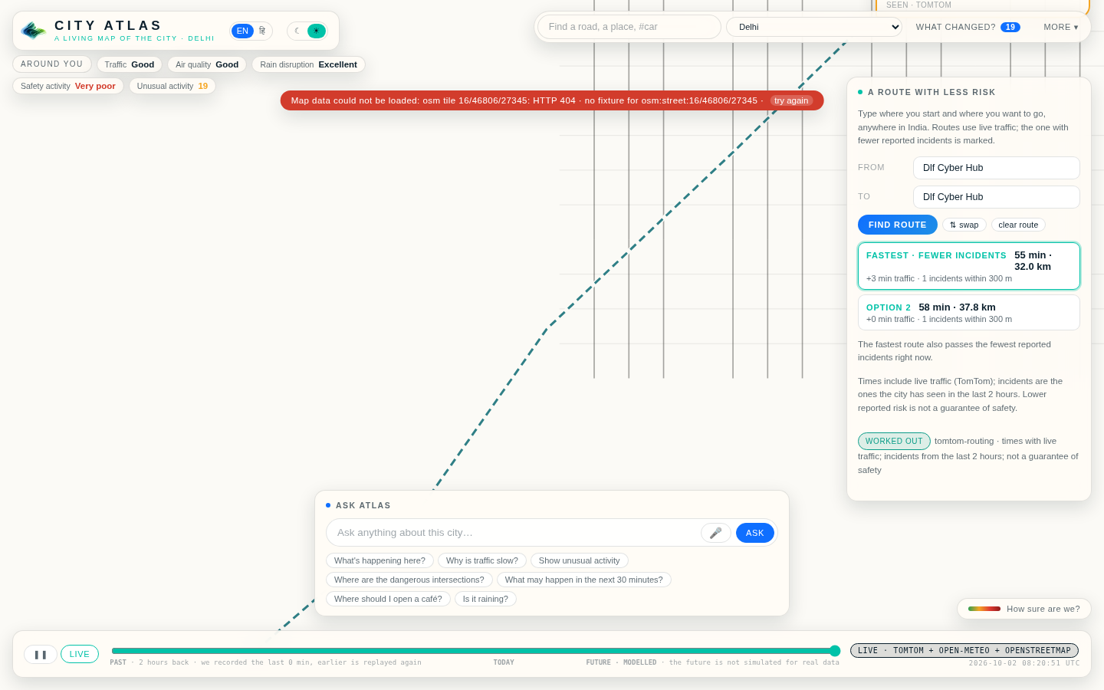
Which way home is calmer? Anywhere in India, with live traffic.
Type any place or lane; routes come from the live routing engine with today’s traffic.
Every option shows minutes, kilometres, the traffic delay and the incidents the city has seen within 300 m of it.
The route with strictly fewer reported incidents is marked. It is never called “safe”.
Zones count who walks in and out from a phone camera: dots, not faces. Alerts arrive by WhatsApp or SMS.
Notes:
Screenshot: route options between two places found across India.

Slide 9
SEE
WHAT IS.
Live traffic, incidents, air and rain. Nothing made up.

Slide 10
Free: what is here. Plus: what it means for you. Pro: what it means for a decision.
CITY ATLAS
CITY ATLAS PLUS
CITY ATLAS PRO
Know your surroundings.
Understand how your city affects you.
Turn location into intelligence for serious decisions.
Conditions around you
Click anywhere: the place card
Ask Atlas
Traffic, safety, air, rain
Three changes since yesterday
Routes with live traffic
Unlimited Ask Atlas
Live-here views
Before you rent or buy
Compare three areas
Watch areas and see them move
Alerts by WhatsApp or SMS
Site finder for a purpose
Scenario Lab: road closes
Project workspace, GeoJSON/CSV
Client reports to PDF
Everything in Plus
Never paywall basic knowledge. Paywall computational leverage.
Notes:
Plus and Pro open with a password today; accounts and billing follow tested pricing.

Slide 11
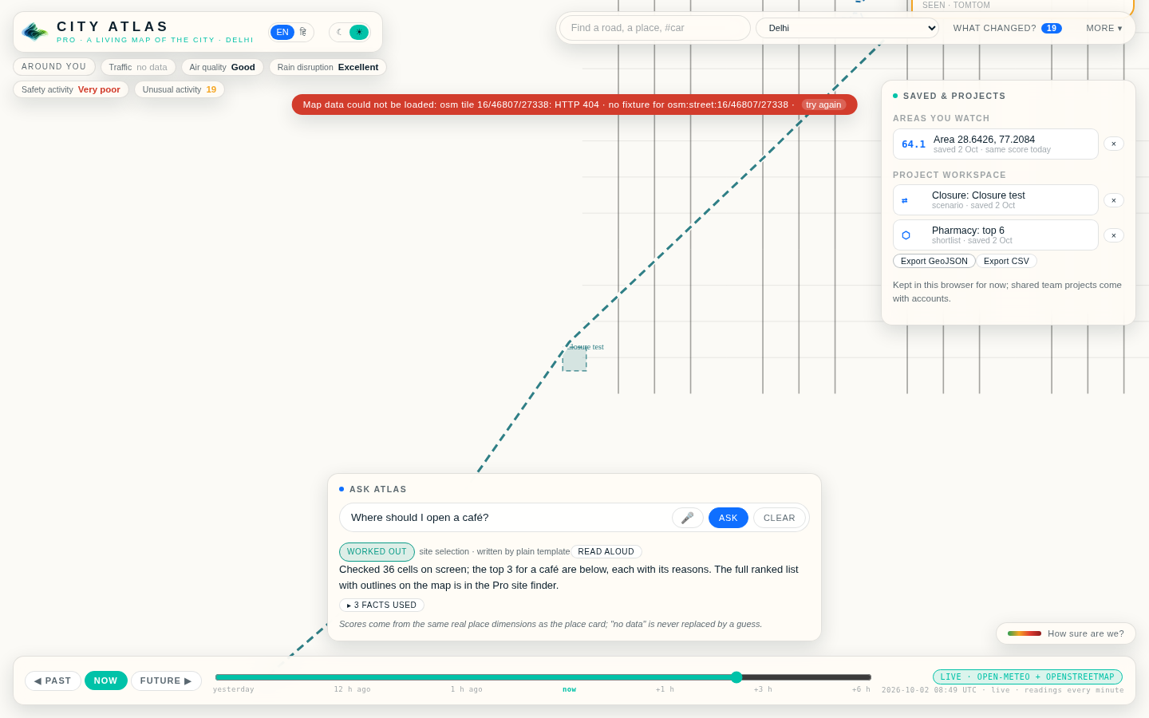
Pro: a workstation on the same city model.
Site finder
Pick café, pharmacy, clinic, school, shop, office, warehouse or home. The hexagons on screen are ranked from the same real scores; a gap in supply counts for a pharmacy; every candidate says why and what has no data.
Scenario Lab
“Road closes” removes the drawn area from the network and the live router re-plans the trip. Metro, new development and signal timing are listed as not modelled, with the reason.
Projects and reports
Shortlists, scenarios and watched areas saved to a workspace, exported as GeoJSON or CSV; a client report with every score’s class, confidence and source.
Notes:
Screenshot: the project workspace with a watched area, a scenario and a shortlist.

Slide 12
One city model. Everything flows through it.
SOURCES
MEMORY
REASONING
WORDS
MAP
OpenStreetMap
TomTom
Open-Meteo
Camera, uploads
Every reading kept
H3 cells
28-day baselines
Daily snapshots
Place state
Changes
Routing
Site finder
Forecast
Ask Atlas
English / Hindi
Facts in, prose out
Ink tiers
Traffic colours
Callouts
Time bar
→
→
→
→
FastAPI + SQLite on one Render service · React, Vite and TypeScript in the browser · the fogleman/ln line engine and the Shan Shui chunk pipeline for the ink.
Notes:
The server holds the model; the browser draws it.

Slide 13
Built, tested, deployed. Today.
141
28
28 d
0
automated tests, web and server
states and territories, one movable frame
of memory per road, by weekday and hour
simulated cars, people or incidents on the real map
Honesty rules the product keeps: nothing simulated for a real region; every number says how it knows; “no data” is never replaced by a guess; camera counts stay on the device.
Notes:
107 web tests and 34 server tests at the time of this deck.

Slide 14
ASK THE CITY.
infrashield-bengaluru.onrender.com

